Slide 1
Transformers in the Real World: A Survey on NLP Applications
By
Narendra Patwardhan, Stefano Marrone and Carlo Sansone

Slide 2
Presented By
Kazi Habibur Rahaman
ID: 20101559
CSE431
Section: 02

Slide 3
Transformers
Introduced first at 2017 by the paper titled “Attention is All you Need”. [1]
Two main components: a multi-head self-attention mechanism and a fully connected feedforward network
More effective than traditional recurrent or convolutional models.
Processing input sequences parallely by using self-attention mechanism .
Few Revolutionized Transformers Models: BERT, GPT, CoPilot

Slide 4
Paper Summary
Many successful applications of transformers (e.g. GPT-3, CoPilot) are closed-source
Researchers can not access their algorithms and codes to improve them further
Closed development practices also raise ethical questions
This paper surveys open-source real-world applications of transformers in the field of NLP along with their challenges and limitations

Slide 5

Methodology
PapersWithCode: Used for collecting and creating initial corpus of real life NLP applications
Use of Levenshtein distance to select entries with less degree of similarities.
Removing entries composed solely of uppercase letters
Removing entries with few character counts and numbers
Removing entries with more than five words

Slide 6
Applications Categorized
Unimodal NLP applications
Deal with single modality, such as text or speech
Multimodal NLP applications
Deal with multiple modality at once, for example, text, speech and image
Transformer Architecture:
Encoder-only Transformer
Decoder-only Transformer
Encoder-Decoder Transformer

Slide 7
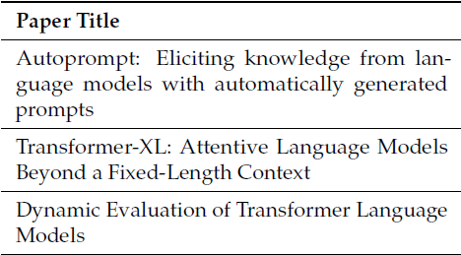
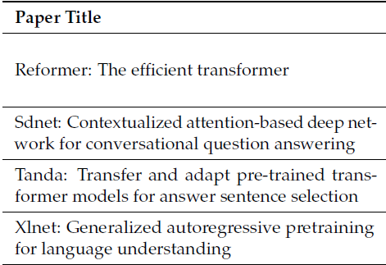
Unimodal Applications
Decoder-only Architecture
Language Modeling
predicting the next word in a sequence
Usually large sized models
Computationally expensive to fine-tune for specific tasks
Question Answering
Open-Domain Question Answering (ODQA)
Conversational Question Answering (CQA)
Answer Selection:
Machine Reading Comprehension (MRC)

Slide 8
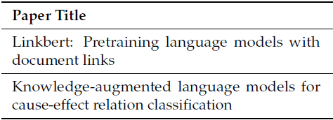
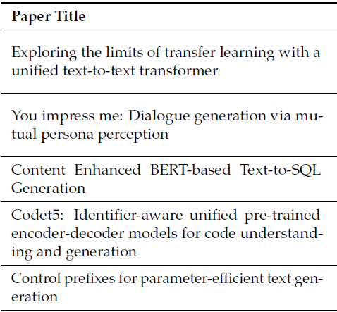
Unimodal Applications
Decoder-only Architecture
Text Classification
Document Classification
Cause and Effect Classification
Text Generation
Dialogue Generation
Code Generation
Data-to-Text Generation

Slide 9
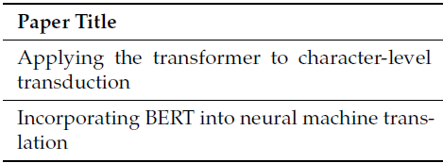
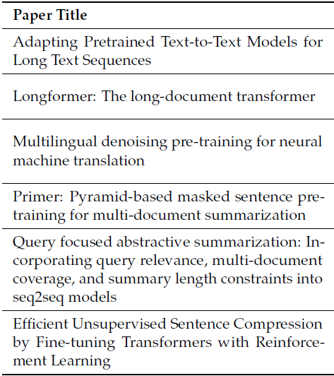
Unimodal Applications
Encoder-Decoder Architecture
Machine Translation
Transliteration
Unsupervised Machine Translation (UMT)
Bilingual Lexicon Induction (BLI)
Text Summarization
Text Summarization
Abstractive Summarization
Multi-Document Summarization
Query-Focused Summarization
Sentence Compression

Slide 10
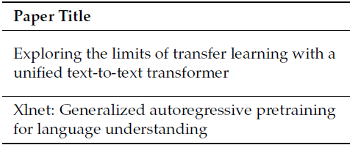
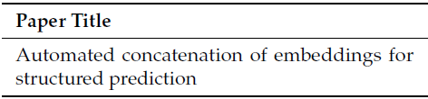
Unimodal Applications
Encoder-only Architecture
Sentiment Analysis
Depends on subjectivity of the text
Also depends on tone and context
Most known models: T5 [2], XLNet [3]
Named Entity Recognition (NER)
Token-wise classification
Uses supervised learning
Model: Automated Concatenation of Embeddings (ACE)

Slide 11
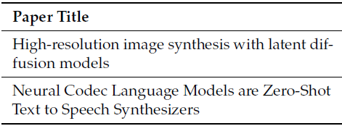
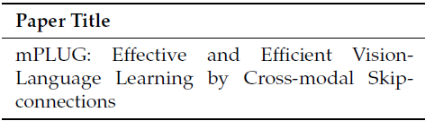
Multimodal Applications
Generative Control:
From text to another modality
Text to image: Rombach et al. [4]
Open source: StableDiffusion
Text to speech: Wang et al. [5]
Description Generation
text is generated to describe another modality
mPLUG [6], a new vision-language model

Slide 12
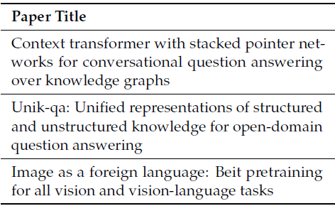
Multimodal Applications
Multimodal Question Answering
answering questions about a given multimodal input
requires the integration of NLP, computer vision, and other relevant modalities
Some models: Plepi et al. [7], Unik-qa [8], BEiT [9]

Slide 13
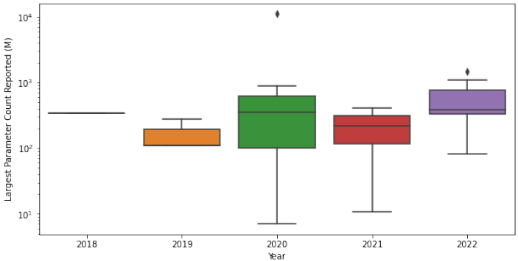
Discussion on Transformers
Research tends to focus on larger models with increasing parameter counts
Real-world applications often rely on models with fewer parameter counts
Smaller models can produce comparable or even better results than larger ones, mainly when training data are limited
Reported parameter count of the largest model by year

Slide 14
Conclusion
Transformers Have proven effective In:
Addressing long-range dependencies
Scalability
Versatility
Benefits of Open-source implementations:
facilitate a more transparent and inclusive environment
enables researchers and practitioners from various backgrounds to build upon, refine, and adapt existing models and techniques

Slide 15
Limitations
The paper provides source code for each application but does not show any of their results within the result
A comparison between the different models of the same field would have given the readers more understanding on the model’s efficiency.

Slide 16
References
Vaswani, A.; Shazeer, N.; Parmar, N.; Uszkoreit, J.; Jones, L.; Gomez, A.N.; Kaiser, Ł.; Polosukhin, I. Attention is all you need. Adv. Neural Inf. Process. Syst. 2017, 30, 3058.
Raffel, C.; Shazeer, N.; Roberts, A.; Lee, K.; Narang, S.; Matena, M.; Zhou, Y.; Li, W.; Liu, P.J. Exploring the limits of transfer learning with a unified text-to-text transformer. J. Mach. Learn. Res. 2020, 21, 5485–5551.
Liu, Q.; Chen, Y.; Chen, B.; Lou, J.G.; Chen, Z.; Zhou, B.; Zhang, D. You impress me: Dialogue generation via mutual persona perception. arXiv 2020, arXiv:2004.05388.

Slide 17
References
Rombach, R.; Blattmann, A.; Lorenz, D.; Esser, P.; Ommer, B. High-resolution image synthesis with latent diffusion models. In Proceedings of the IEEE/CVF Conference on Computer Vision and Pattern Recognition, New Orleans, LA, USA, 24–28 June 2022; pp. 10684–10695.
Wang, C.; Chen, S.;Wu, Y.; Zhang, Z.; Zhou, L.; Liu, S.; Chen, Z.; Liu, Y.;Wang, H.; Li, J.; et al. Neural Codec Language Models are Zero-Shot Text to Speech Synthesizers. arXiv 2023, arXiv:2301.02111.
Li, C.; Xu, H.; Tian, J.; Wang, W.; Yan, M.; Bi, B.; Ye, J.; Chen, H.; Xu, G.; Cao, Z.; et al. mPLUG: Effective and Efficient Vision-Language Learning by Cross-modal Skip-connections. arXiv 2022, arXiv:2205.12005.

Slide 18
References
Plepi, J.; Kacupaj, E.; Singh, K.; Thakkar, H.; Lehmann, J. Context transformer with stacked pointer networks for conversational question answering over knowledge graphs. In Proceedings of the The Semantic Web: 18th International Conference, ESWC 2021, Online, 6–10 June, 2021; Springer: Berlin/Heidelberg, Germany, 2021; pp. 356–371.
Oguz, B.; Chen, X.; Karpukhin, V.; Peshterliev, S.; Okhonko, D.; Schlichtkrull, M.; Gupta, S.; Mehdad, Y.; Yih, S. Unik-qa: Unified representations of structured and unstructured knowledge for open-domain question answering. arXiv 2020, arXiv:2012.14610.
Wang,W.; Bao, H.; Dong, L.; Bjorck, J.; Peng, Z.; Liu, Q.; Aggarwal, K.; Mohammed, O.K.; Singhal, S.; Som, S.; et al. Image as a foreign language: Beit pretraining for all vision and vision-language tasks. arXiv 2022, arXiv:2208.10442.

Slide 19
Thank You

